Slide 1

Adult Income Dataset
Data storytelling
Rayees Ahamed B
Springboard Data Science Student (2021-2022)

Slide 2
The Problem
An individual’s annual income results from various factors
What influences an adult's income?
Demographics
Age
Education
Gender
Can we predict adults' income based on personal information?

Slide 3
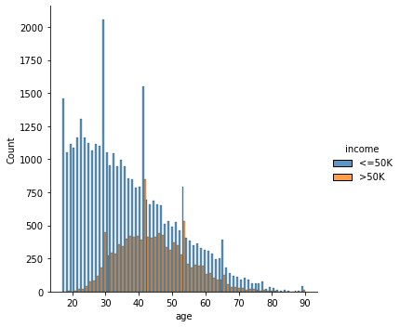
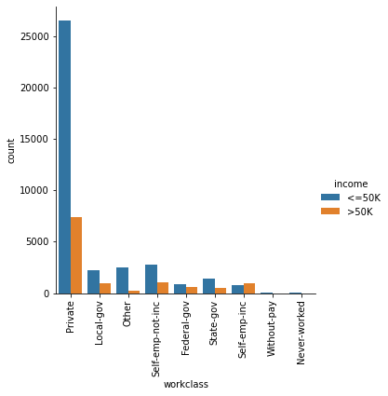
Exploratory Data Analysis - Age, Working class vs Income
Age vs Income comparison
Working class vs Income
Adults aged from 21 to 65 are received income above or equal to $50K
Most young aged adults received salary of below $50K
Private job holders earn most high salary regardless of income level when compared to other jobs

Slide 4
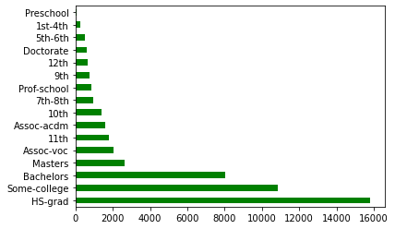
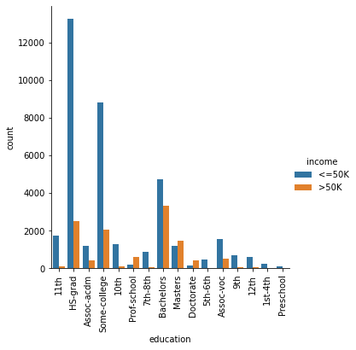
Exploratory Data Analysis – Education level vs Income
Education level among adults
Income vs education level
Most of the working adults are educated with either high school, college or university degree
Low earning population (<50K) just have HS-grad or some college degree
High earning population (>50K) have bachelor or master degree
Clearly, education levels play important role in adult income prediction

Slide 5
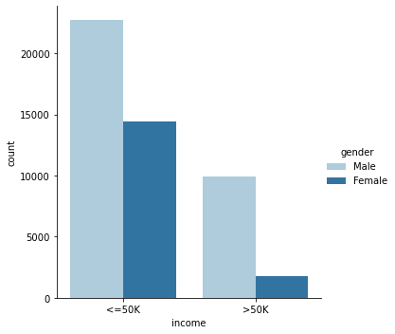
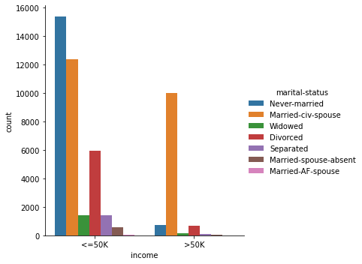
Does gender or marital status affect adults' income?
Income distribution by gender
Income distribution by marital status
Higher number of male population receive far more high salary than female population
In less than $50k income level, never married adults received more salary
But, in above $50k income level, married individuals received more salary

Slide 6
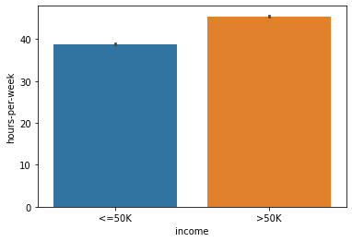
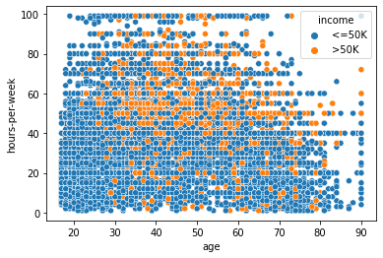
Does working more hours earn more salary?
Working hours vs income
Relationship of age, work hours and income
Both high and low salary category adults worked very similar hours per week
Interestingly, high income generating adults comparatively worked more hours than rest of all
All age groups worked similar hours per week
Average working hours by income:
Above $50k – 45 hours
Below $ 50k – 38 hours

Slide 7
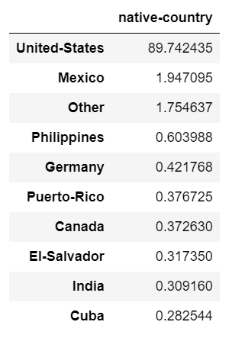
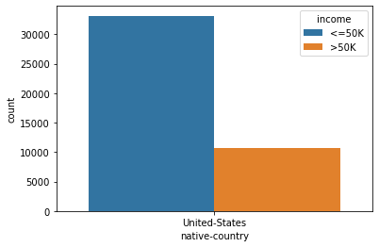
Native country and income level
Around 90% adults in this dataset are from United States
Other countries has less than 2% of adults
In United States, significant number of adults are earning below $50k
Less than 10000 adults are earning above equal to $50k annual income

Slide 8








Summary
An individual’s annual income are greatly influenced by several factors
Important features for adult income prediction:
Age
Working class
Educational level
Gender
Marital status
Native country
All these variables can have greater impact on an individual’s income status

